Slide 1
LANGUAGE AND LITERATURE
Tanushree Sanwal, Assistant Professor, KSOM

Slide 2
Language
Language in its literary meaning is a system of communication through speech, a collection of sounds that a group of people understand to have the same meaning.
A language family includes individual languages related through a common ancestor that existed before the recorded history.
Dialect is a form of language spoken in a local area. It should be noted that several dialects can be derived from a particular language.
The languages spoken around the various corners of India belong to several languages families where most of them belong to the Indo Aryan group of languages

Slide 3
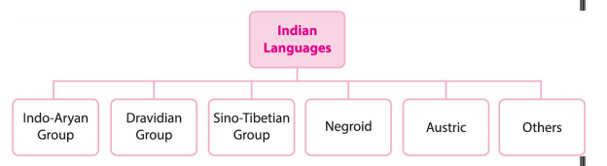
CLASSIFICATION OF INDIAN LANGUAGES

Slide 4
Indo-Aryan Group of Languages
It is a branch of the larger Indo-European family which came to India with the advent of the Aryans.
It is the largest language group of India and around 74% of the Indians speak those languages which belong to this group. This language group is again sub-divided into three groups depending upon the time period of their origin.(Old Indo-Aryan Group , Middle Indo-Aryan Group, Modern Indo-Aryan Group)

Slide 5
Old Indo-Aryan Group
This group had its development around 1500 B.C. and Sanskrit was born out of this group.
The ancient form of Sanskrit is what we find in the Vedas. Even Upanishads, Puranas and Dharmasutras were all written in Sanskrit. It can be said that Sanskrit is the mother of many Indian languages.
The understanding of the diversity and richness of our culture has been possible all because of the development of Sanskrit language during those times.
It is the most ancient language of our country and is one of the 22 scheduled languages listed in the Constitution.

Slide 6
Development of Sanskrit
The development of Sanskrit grammar began with Panini in 400 B.C. with his book Asthadhyayi being the oldest book in Sanskrit grammar.
Some of the Buddhist literature belonging to Mahayana and the Hinayana school are even written in Sanskrit language and Ashvagosha’s Buddhacharita were also written in Sanskrit.

Slide 7
Sanskrit
Sanskrit is the only language that transcended the barriers of region and boundaries.
The chaste form of Sanskrit developed in between 300 BC to 200 BC. It was a refined version of Vedic Sanskrit.
The first evidence of the use of Sanskrit can be found in the inscriptions of Rudradamana at Junagarh in the present Southern Gujarat region. However it was the Gupta period when the use of Sanskrit in poetries can be traced.

Slide 8
Middle Indo-Aryan Group
The period of development of this sub-group is between 600 BC to 1000 AD and started with the development of Prakrit language.
Prakrit is understood to mean natural, original, casual, etc, and which explains to us that it did not have strict rules of usage and was the common tongue.
Many languages such as Ardha-Magadhi, Pali (used by Theravada Buddhists), Apabhramsha, find their origin from the Prakrit.
Prakrit was associated with the common people. On the other hand, Sanskrit was orthodox, had fixed rules and was used by learned people or the elites, especially Brahmins.
The writing of texts in Prakrit is relatively a late development, as compared to Sanskrit.

Slide 9
Prakrit includes:
Pali: It was widely spoken in Magadha. It was popular during 5th- 1st century BC. It is closely related to Sanskrit, and the texts in Pali were written generally in Brahmi script. The Tripitaka of Buddhism were also written in Pali. It serves as the lingua franca of Theravada Buddhism. It is believed that Buddha himself did not speak in Pali but gave his preachings in ardha-magadhi language.

Slide 10
Magadhi Prakrit or Ardha-Magadhi:
It is the most important kind of Prakrit. Its literary use increased after the decline of Sanskrit and Pali. 1000 AD and started with the development of Prakrit language. Buddha and Mahavira perhaps spoke in Ardha-Magadhi. It was the court language of few Mahajanapadas and also the Mauryan dynasty. Several Jain texts and Rock edicts of Ashoka were also written in Ardha-Magadhi. It later evolved into languages of Eastern India namely Bengali, Assamese, Odia, Maithili, Bhojpuri, etc.

Slide 11
Shauraseni: It was widely used to write dramas in the medieval India. It is a predecessor to Northern Indian languages. Jain monks wrote mainly in this version of Prakrit. An important text of Digambars, ‘Shatkhandgama’ is written in Shauraseni.
Maharashtri Prakrit: Spoken till 9th century AD, it was a predecessor to Marathi and Konkani. It was used widely in western and southern India. It was the official language of Satavahana dynasty. Several dramas were written in it like ‘Gaha Kosha’ by King Hala, ‘Gaudavaho’ (slaying of the king of Gauda) by Vakpati.

Slide 12
Elu: ancient form of modern Sinhala language of Sri Lanka, it is similar to Pali.
Paishachi: It is also called ‘Bhuta-Bhasa’ (dead language) and it is often regarded as Prakrit. Gunadhya’s Brihatkatha (6th century), an ancient epic is written in Paishachi. It is regarded as an unimportant dialect.

Slide 13
Modern Indo-Aryan Group
The languages belonging to this group are Hindi, Assamese, Bengali, Gujrati, Marathi, Punjabi, Rajasthani, Sindhi, Odia, Urdu etc.
The languages under this sub-group developed gradually after 1000 AD. These languages are mainly spoken in the northern, western and the eastern parts of India.

Slide 14
Classical Sanskrit Literature
Most of the literature in Sanskrit has been divided into the Vedic and the Classical categories. The two epics: Mahabharata and Ramayana are also part of the classical category but are discussed separately because of their religious importance.

Slide 15
Sanskrit Drama
The rules regarding the performance, acting, gestures, stage direction and acting have been illustrated in the Natyasastra by Bharata (1 BC–1 AD).
Major dramas written in this period are by Kalidasa :
Malavikagnimitra (The love story of Malavika a maiden of Queen and Agnimitra the son of Pushyamitra Shunga)
Vikramorvasiya (Love story of Vikram and Urvasi)
Abhigyana Shakuntala (the recognition of Shakuntala)

Slide 16
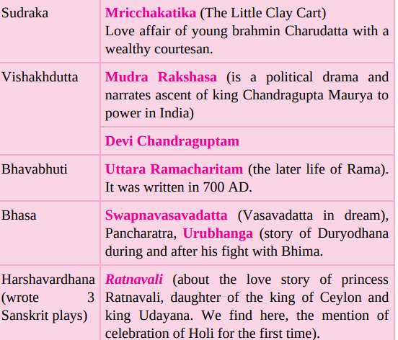

Slide 17
Sanskrit Poetry
This genre is also called Kavya or poetry.
One of the greatest Sanskrit poets is Kalidasa who wrote Kumara Sambhava (the birth of Kumar), and Raghuvamsa (the dynasty of the Raghus). He also wrote two smaller epics called Meghaduta (the cloud messenger) and Ritusamhara (medley of seasons).

Slide 18
One should not forget to mention the contribution of poets like
Harisena who wrote during the Gupta period. He wrote several poems in praise of valour of Samudra Gupta and it was so well appreciated that it was inscribed on the Allahabad pillar.
Another extremely popular Sanskrit poet was Jayadeva who wrote Gita Govinda in the 12th century. It concentrates on the life and escapades of Lord Krishna. The text combines elements of devotion to Lord Krishna, his love for Radha and the beauty of nature.
Other major poets are: Bharavi (550 A.D.) Kiratarjuniyam (Kirat and Arjun) Magha (65-700 A.D.) Sishupalavadha (the killing of Shishupal)

Slide 19
Other Major Sanskrit texts
Historians argue that between 500 and 200 BC, several major books on law were written and complied, which are called the Dharamsutras. These were compiled alongside the smritis that are known as Dharamshastras.
These are the basis of the laws governing the subjects of most Hindu kingdoms. These not only elucidate the rules according to which property could be held, sold or transferred but also elaborated on the punishments for offences ranging from fraud to murder.

Slide 20
Manusmriti
Another major text is Manusmriti (laws of Manu), which defines the role of man and woman in a society, their interaction at a social plane and the code of conduct that they were supposed to follow. The text is written as a discourse given by Manu, the ancestor of mankind. The Manusmriti might have been written and compiled during 200 BC and 200 AD.

Slide 21
Kautilya’s Arthashastra
One of the most famous texts about statecraft from the Mauryan period is Kautilya’s Arthashastra.
It concentrates on the economic and social conditions of the Mauryan empire.
Due focus was given to the military strategy which should be employed by the state.
.The text mentions that ‘Kautilya’ or ‘Vishnugupta’ wrote it. Historians argue that both these names were an alias for Chanakya who was a learned scholar at the court of Emperor Chandragupta Maurya

Slide 22
The title Arthashastra is often translated to "the science of wealth" (अर्थ),[but the book Arthashastra has a broader scope.
It includes books on the nature of government, law, civil and criminal court systems, ethics, economics, markets and trade, the methods for screening ministers, diplomacy, theories on war, nature of peace, and the duties and obligations of a king.
The text incorporates Hindu philosophy, includes ancient economic and cultural details on agriculture, mineralogy, mining and metals, animal husbandry, medicine, forests and wildlife

Slide 23
Literature in Pali and Prakrit
During the post-Vedic period, apart from Sanskrit, literature was also composed in Prakrit and Pali. Prakrit is a term which is loosely attached to any language from the standard one, i.e. Sanskrit. Pali is usually used to indicate the archaic or old form of Prakrit and it combines several existing dialects. These languages gained prominence when religious literature of the Buddhists and Jains were composed in this language.

Slide 24
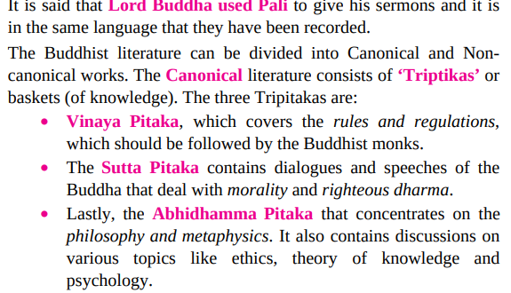

Slide 25
 The Jatakas, composed in the 3rd century BC - 2nd century AD, relate stories of the previous births of the Buddha.
 They have also served to give a glimpse of the social history of the period.
 Buddhaghosha, in the 5th century AD, wrote a commentary on the Tipitaka.
 The Sri Lankan Chronicles from the 5th century – the Dipavamsa and the Mahavamsa – deal with the
Buddha's life, the Buddhist councils, emperor Ashoka and the kings of Sri Lanka.

Slide 26
Jainism, produced texts in Prakrit
Another major religion, Jainism, produced texts in Prakrit.
They form the basis of the Jain canonical literature.
Some of the Jain texts were also written in Sanskrit like the Upamitibhava Prapancha Katha of Siddharasi (906 A.D.).
The most important Jain texts written in Prakrit are the Angas, the Upangas and the Parikramas.
Apart from these the Chhedab Sutra and the Malasutra are also considered to be sacred by the Jains.
Amongst the secular writers attached to the Jains were Hemachandra who wrote a treatise on lexicography and grammar.
Mention could also be made of Haribhadra Suri who wrote in the eighth century. These treatises help us to expound on the sociopolitical history of areas densely populated by the Jaina community, which mostly comprised of traders.

Slide 27
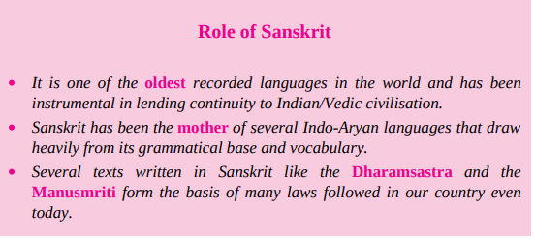

Slide 28
Telugu Literature
Linguists have argued the Nannaya (11th century) was the first poet in Telugu.
Several great works have been written in Telugu but it reached its zenith during the Vijayanagara period that is also known as the golden age of Telugu literature.
One of the most successful works in this period is titled Uttaraharivamsam which was composed by Nachana Somanatha, a well-known court poet of King Bukka I.
Not only were the court poets producing outstanding literature, even the kings like Krishnadevaraya (1509-1529) were composing exceptional poetry titled Amuktamalyada.

Slide 29
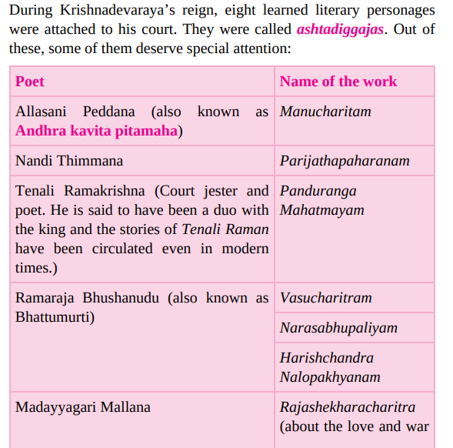

Slide 30
